Slide 1
Ivy Tech Apprenticeships
September 2020

Slide 2
Background
Ivy Tech was on a team that was awarded a $5.9M grant from the United States Government focused on apprenticeships.
NIDIA supported the award of this grant -
The Northeast Indiana Defense Industry Association (NIDIA) strongly supports the American Association of Port Authorities Strong, Secure National Ports and Supply Chain (SNaPS) proposal to create cybersecurity apprenticeship programs. NIDIA will consider partnering with Ivy Tech Community College of lndiana's Fort Wayne Campus (Ivy Tech Fort Wayne) and the American Association of Port Authorities to create and implement cybersecurity apprenticeships in the Northeast Indiana defense industry. NIDIA member industries may also host apprenticeships as part of the programs.

Slide 3
Background
Ivy Tech Community College has partnered with the American Association of Port Authorities ACCELerate Apprenticeships, to help industry learn more about apprenticeship and how it can benefit their workforce.
An Apprenticeship program consists of Related Technical Training and On The Job Learning that allows the apprentice to gain skills, while obtaining experience that leads to a credential.

Slide 4
Background
Listed in the grant are the following Occupations:
Computer Systems Analyst/Manager
Cybersecurity/Information Security Analyst
Computer Support Specialist of Technician
Network and Cybersecurity Systems Administrators
Data Base Administrator
Computer Systems Engineer
Industrial Mechanical
Industrial Electrical
Logistics

Slide 5
How can the Grant Assist with Expanding Apprenticeship?
Provide Tuition assistance to companies enrolling apprentices
Allow Ivy Tech Community College to have the Technology to deliver classes remotely and in different modalities.
Assist Employers with Development of programs and help Ivy Tech Community College be able to provide “concierge” services to apprenticeship companies.
Expanding Apprenticeship allows Industry to provide GOLD standard training programs to increase retention.

Slide 6
Ivy Tech Cyber Security Apprenticeship
Steps to establish your company’s customized apprenticeship program
Identify your occupational needs
Develop an on-the-job work plan
Outline a related instruction plan
Create program guidelines and training
Engage
Launch
Coordinate directly with the Ivy Tech Director of Apprenticeship and Work-Based Learning, Kaylene Smith (260-480-4185)

Slide 7
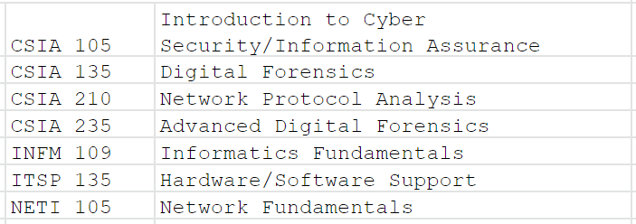
Sample - Ivy Tech Cyber Training Offerings
Here is a sample of Ivy Tech cyber security courses
A more complete list may be found at the link below
https://drive.google.com/drive/folders/1KQzVuYfO6GA0xAos7ZCst1iMa09B_yHG?usp=sharing

Slide 8
Bottom Line
The grant is a means to subsidize training up your staff
Ivy Tech is positioned to help

